Slide 1

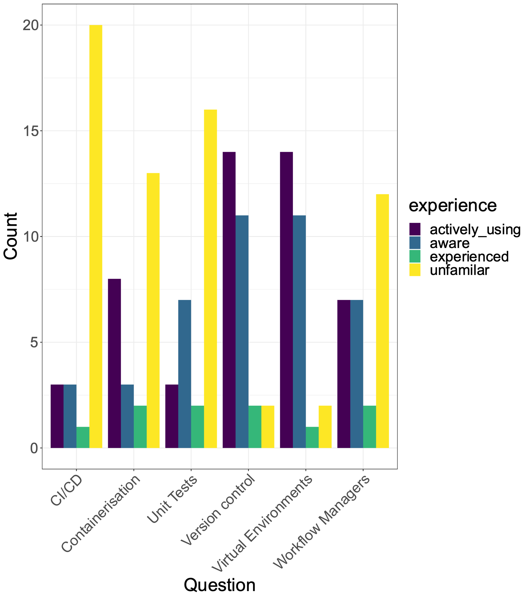
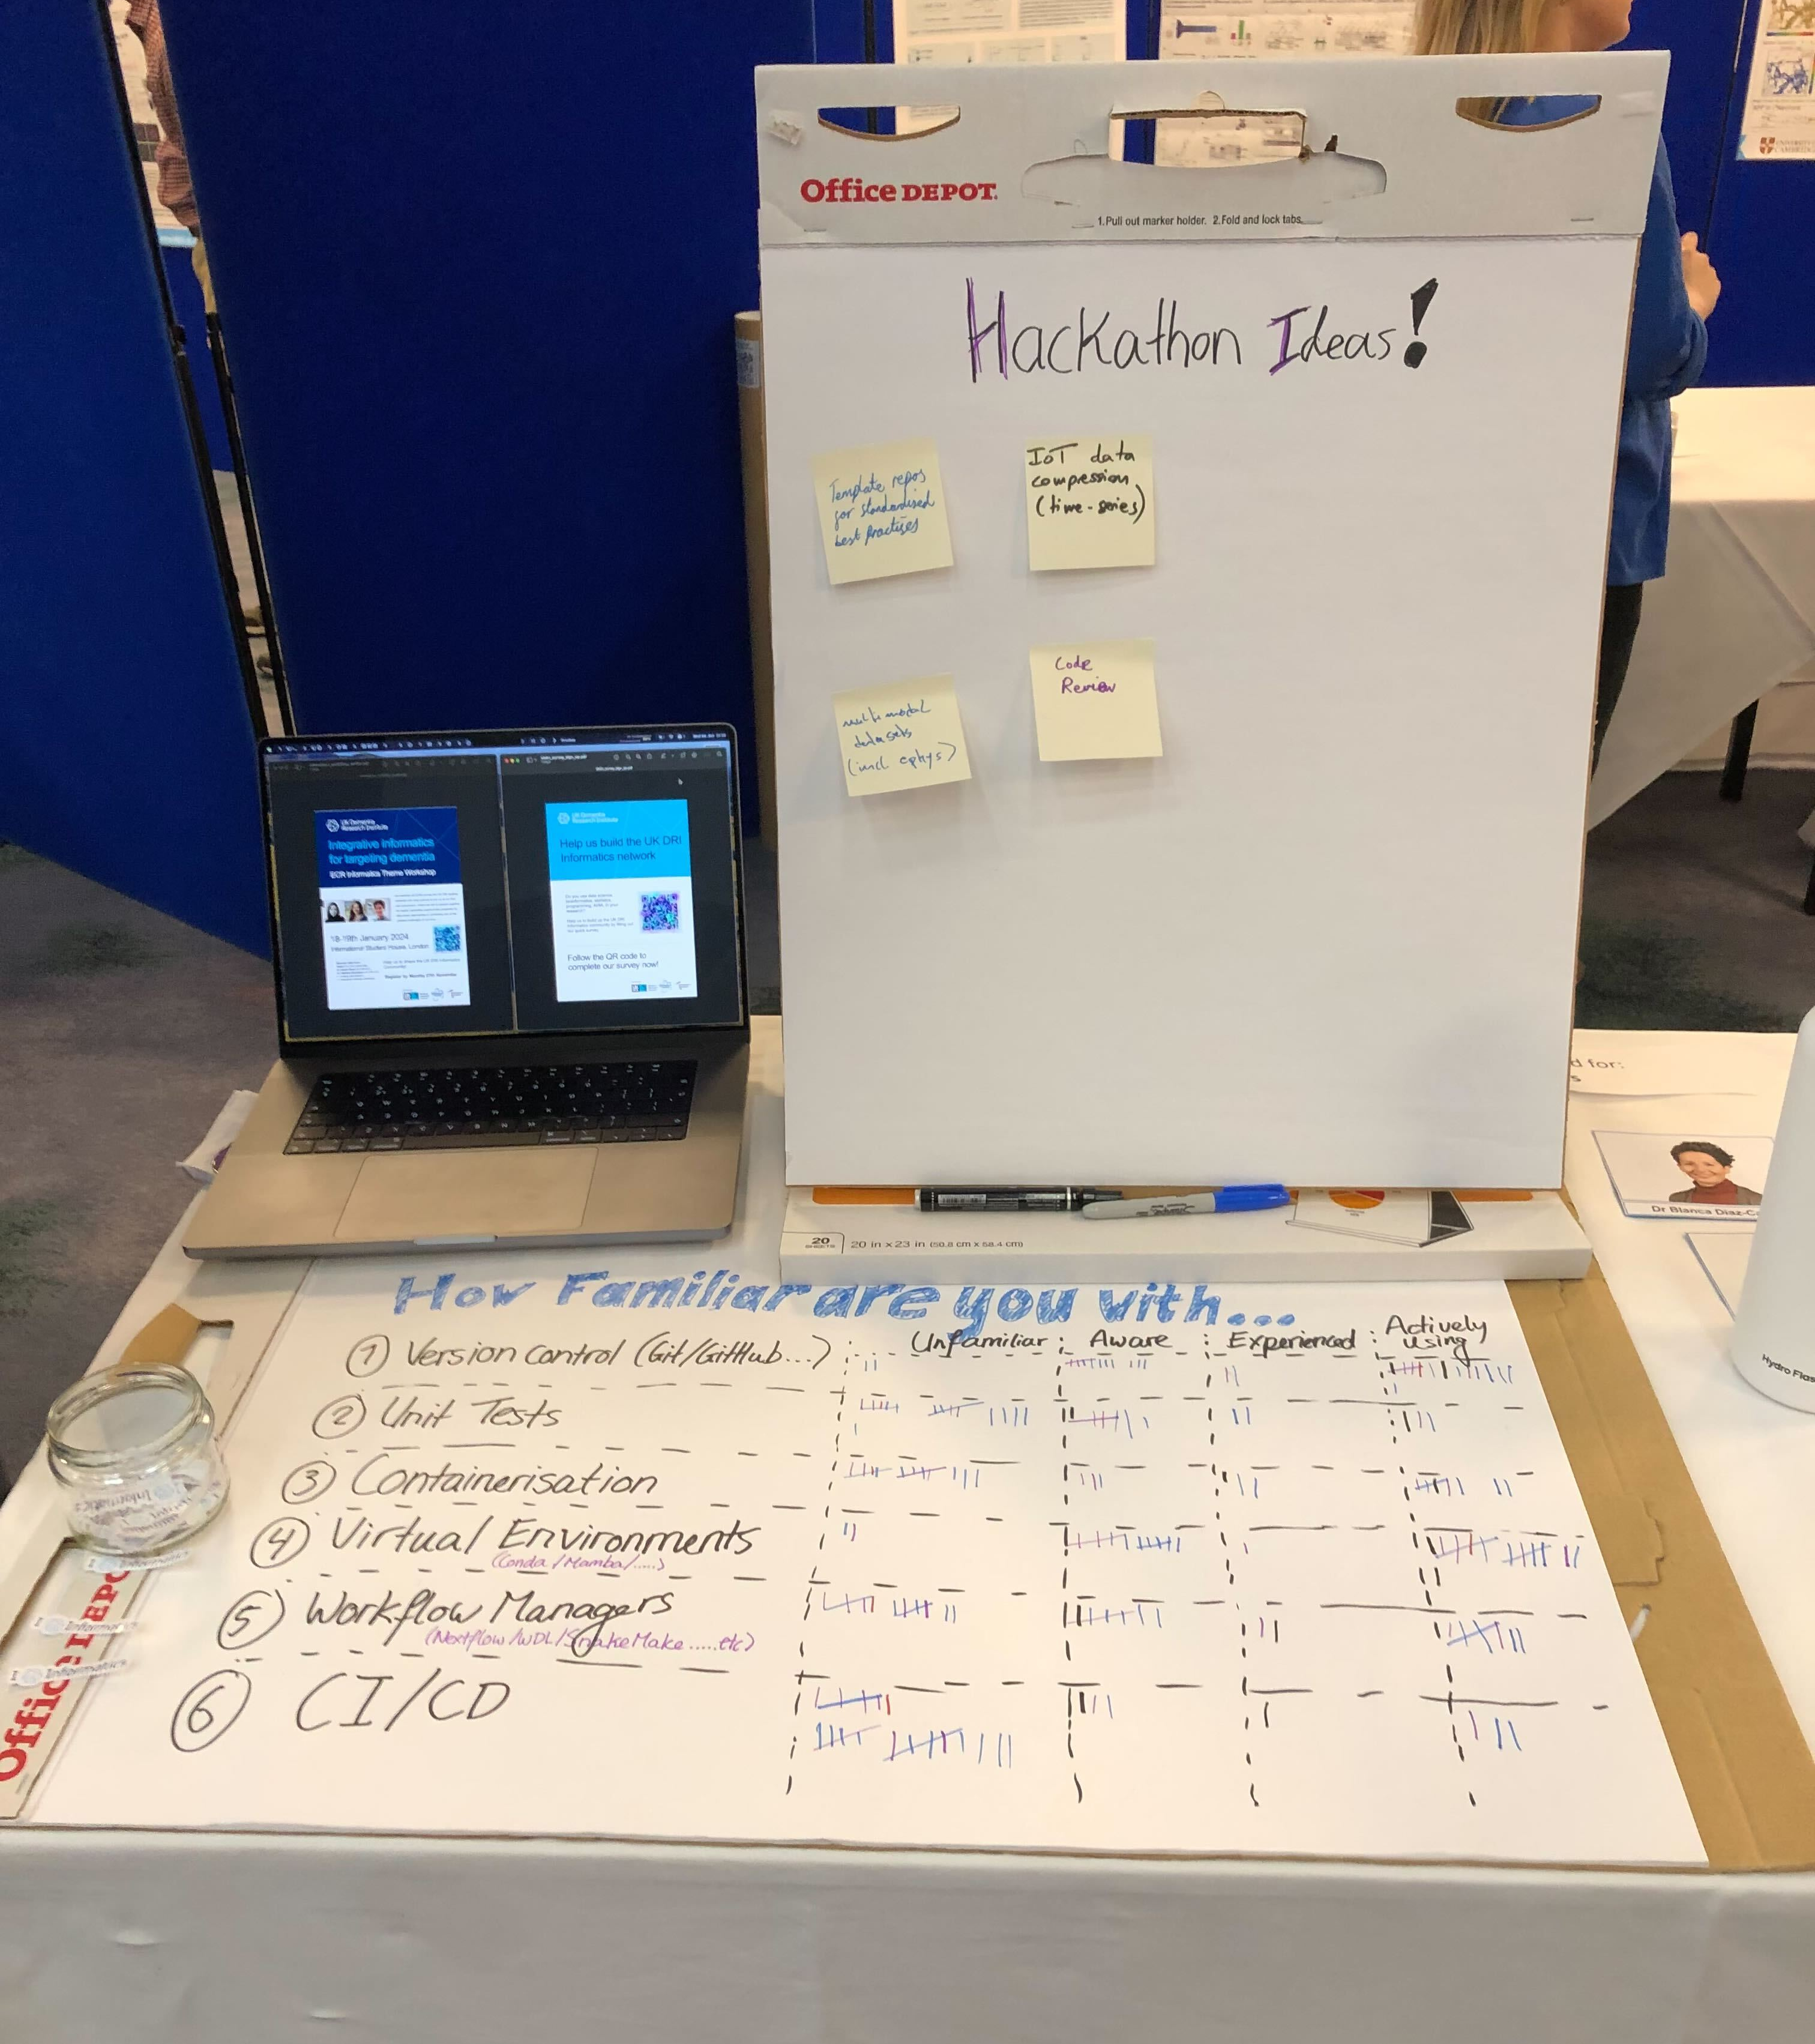



Building the UKDRI
Informatics community
^{ECR Informatics Committee}
Remember this from Connectome?
It evolved into this:
Scan me!
We got a sense of what the informatics committee is familiar with and what they aren’t, a big thanks to all those who came and said hi!
But we want to learn more about our community 🙏
Please fill out our survey, but following the QR code 😀 (❤️ to those who already filled it in)
The next big event is the Hackathon, so any ideas for that are also very welcome!
There are also handy links to the agenda and such on the other side of that QR code😁

